Slide 1

ElastiCache-Redis Cross-Region Replication
P N B PURNA
2000030742
SEC:- 14

Slide 2
Agenda
1
2
3
4
5
Introduction
Steps help to implement
Performance
Timeline
Final Project

Slide 3
Introduction
Global Datastore in Amazon ElastiCache for Redis provides fully managed, fast, reliable and secure cross-region replication. With Global Datastore, you can write to your ElastiCache for Redis cluster in one region and have the data available to be read from two other cross-region replica clusters, thereby enabling low-latency reads and disaster recovery across regions. Designed for real-time applications with a global footprint, Global Datastore for Redis supports cross-region replication latency of typically under 1 second, increasing the responsiveness of your applications by providing geo-local reads closer to end users.

Slide 4
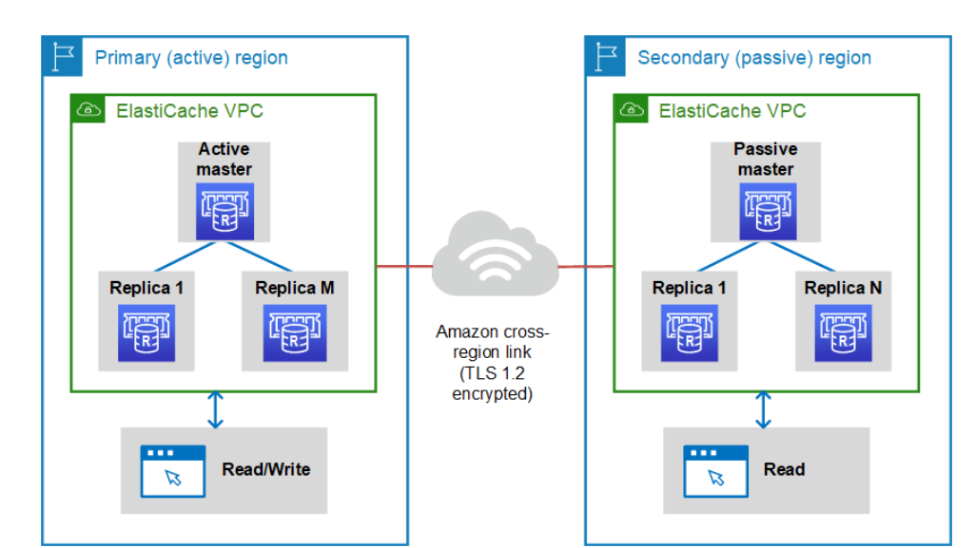
Steps help to implement

Slide 5
Performance
Setting up.
Step 1: Create a subnet group.
Step 2: Create a cluster.
Step 3: Authorize access to the cluster.
Step 4: Connect to the cluster's node.
Step 5: Deleting a cluster.
Tutorials and videos.
Where do I go from here?

Slide 6
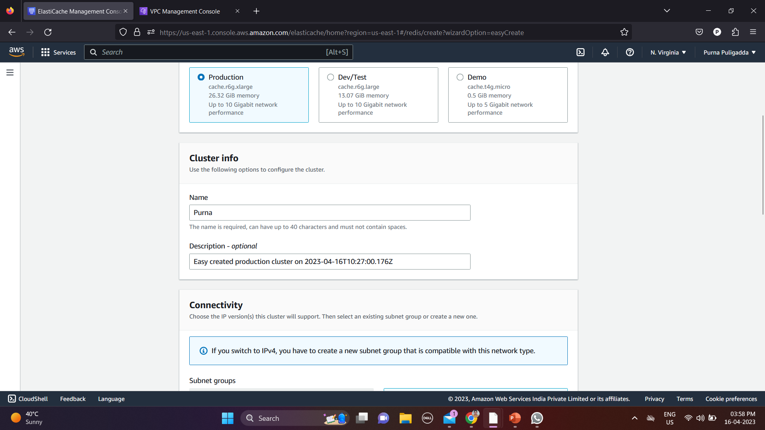
Business opportunities are like buses. There’s always another one coming.
“
”
Richard Branson

Slide 7
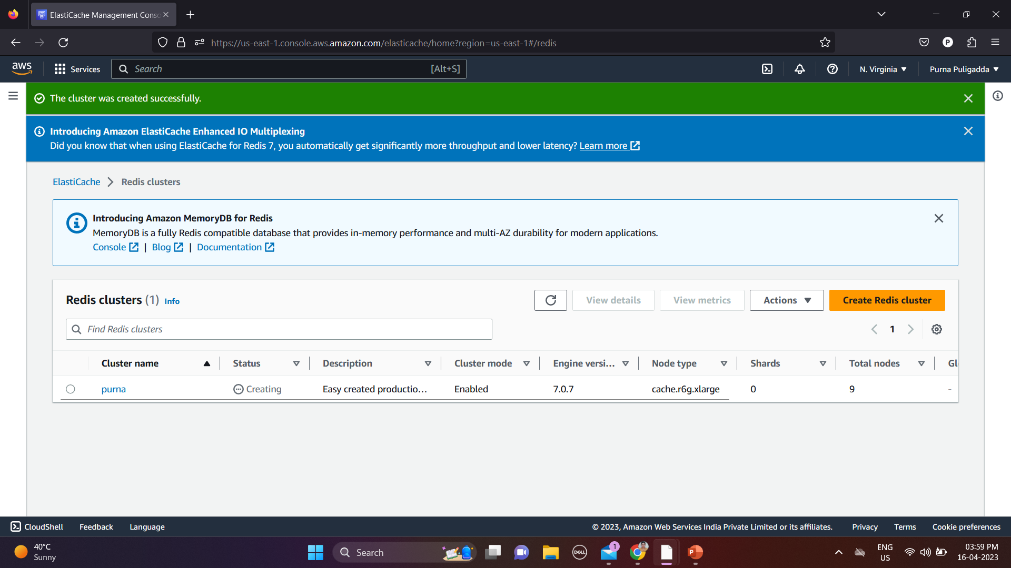
Business opportunities are like buses. There’s always another one coming.
“
”
Richard Branson

Slide 8
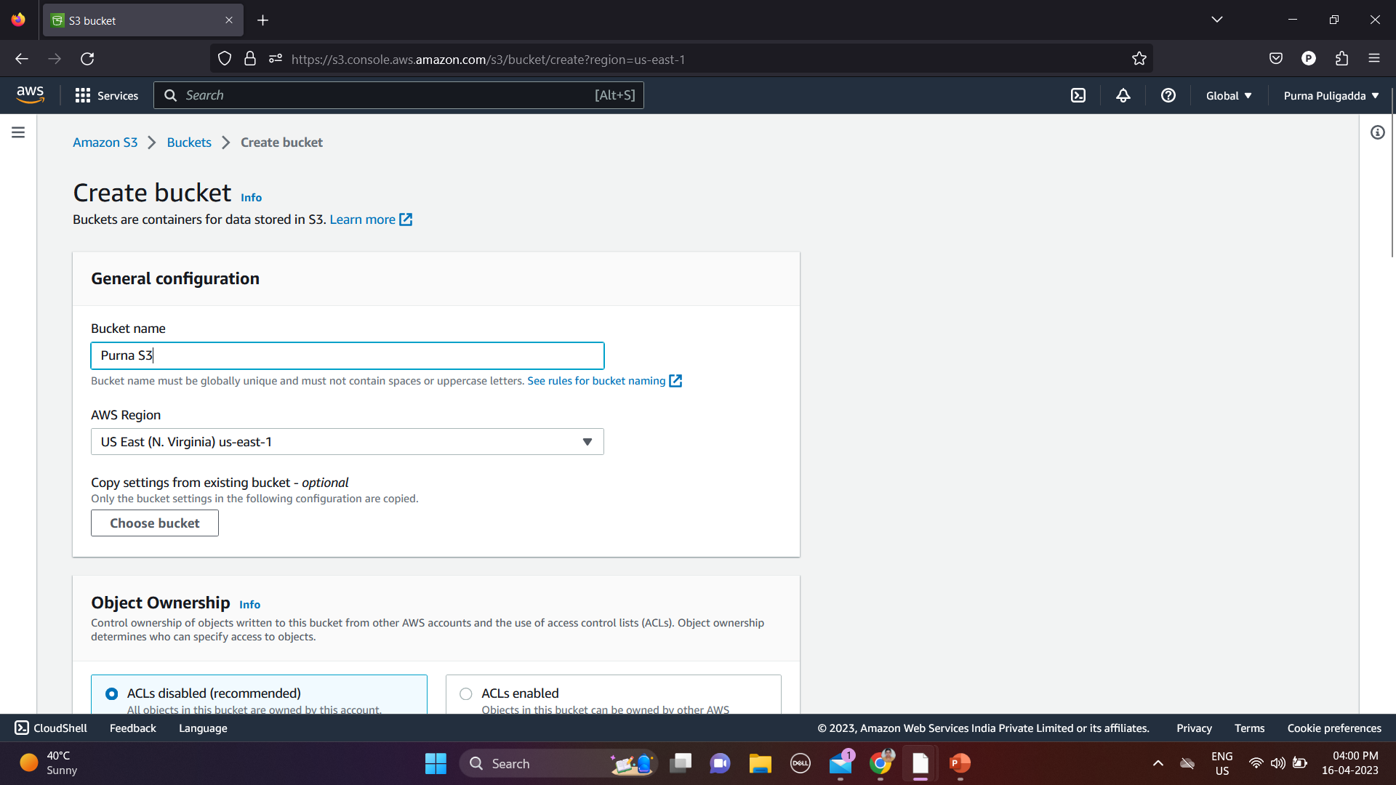
Business opportunities are like buses. There’s always another one coming.
“
”
Richard Branson

Slide 9
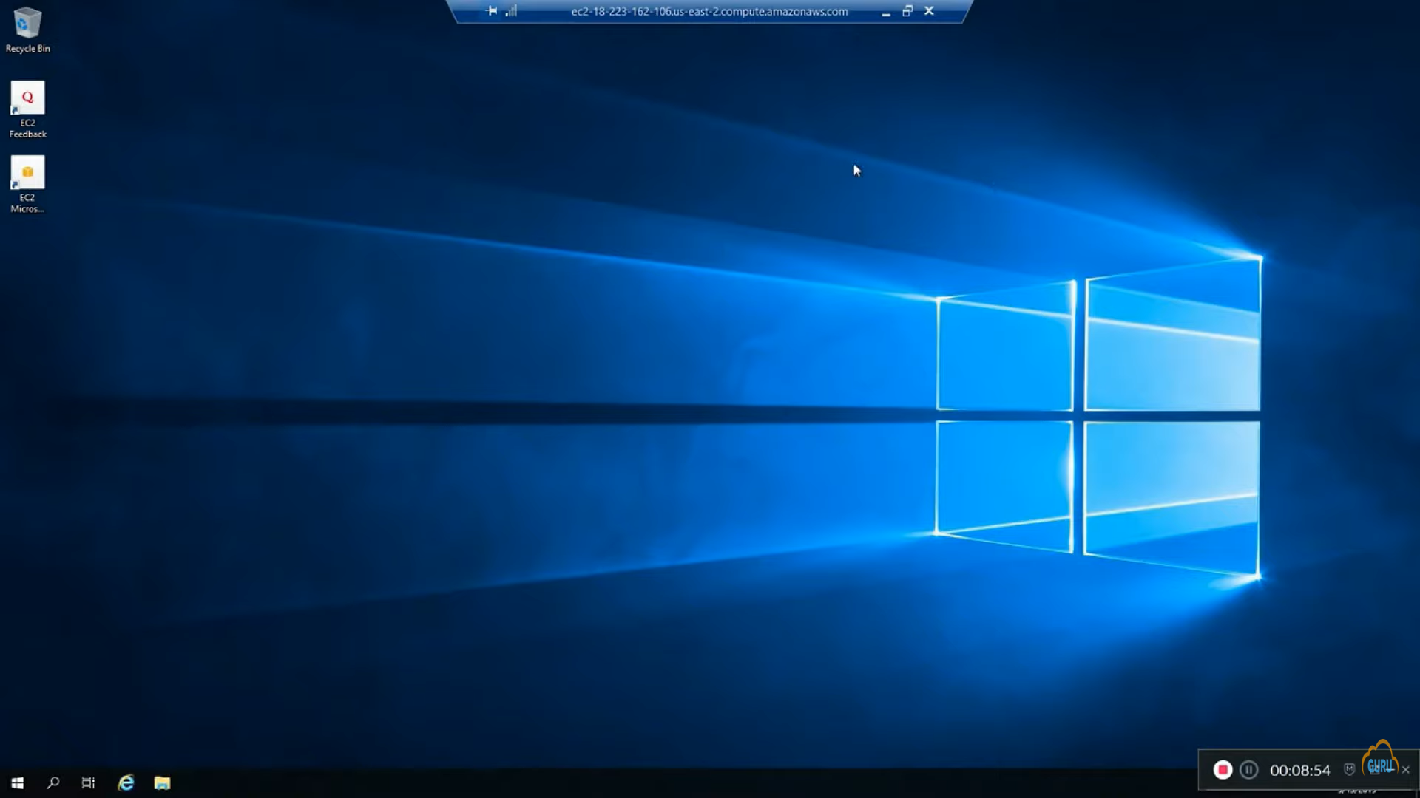
Business opportunities are like buses. There’s always another one coming.
“
”
Richard Branson

Slide 10
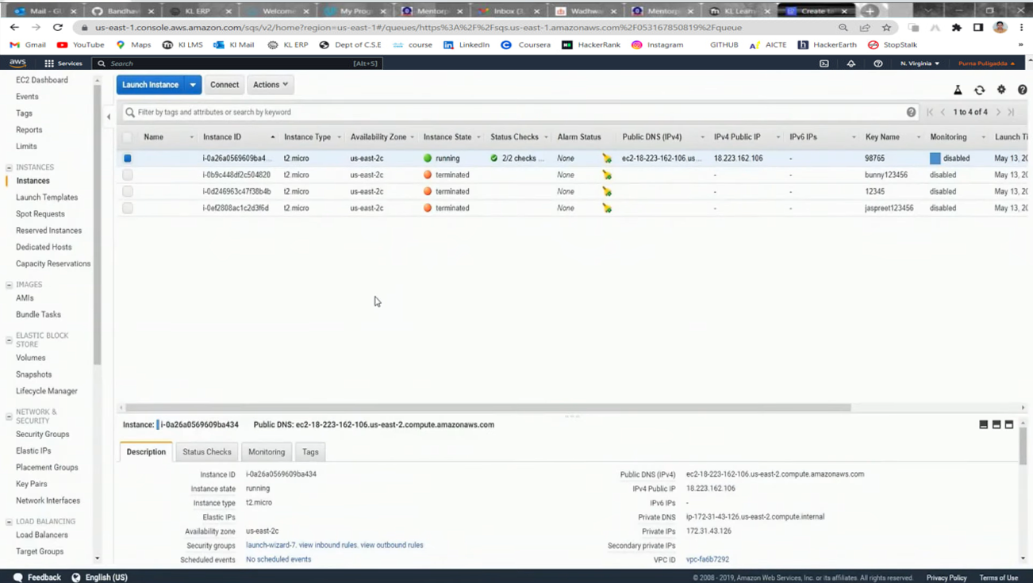
Business opportunities are like buses. There’s always another one coming.
“
”
Richard Branson

Slide 11
Summary
By using the Global Datastore for Redis feature, you can work with fully managed, fast, reliable, and secure replication across AWS Regions. Using this feature, you can create cross-Region read replica clusters for ElastiCache for Redis to enable low-latency reads and disaster recovery across AWS Regions.

Slide 12

Thank you

